Slide 1
Advanced topic Fuzzy testing
Instructor: Shaowei Wang

Slide 2
Administrative item
Final presentation will be on Nov 30 (Thursday), Dec 5 (Tuesday), and Dec 7 (Thursday)
See schedule in google spreadsheet https://docs.google.com/spreadsheets/d/1ewp5bUNU8EbpPAQqRLjMIKLyGNiLejSgUvC55txSoIA/edit#gid=0
Each team will give a ~20 minutes presentation to introduce their project to the class, plus 2 minutes Q&A.
Quick recap of the project (~1-2 minutes)
Demo of the project (~8-10 minutes)
Discussion of the development process (~7-8 minutes).
We will invite all other teams to evaluate the project and rank them.
The weight between students and instructor is 7:3.
More details @Assignments ->Final project presentation

Slide 3
Outline
Fuzz testing
Research in fuzz testing

Slide 4
Fuzz Testing (Fuzzing)
Generates lots of random inputs automatically (including invalid/abnormal) to a program to discover bad behavior such as crashes (without oracle)

Slide 5
Fuzz Testing (Fuzzing)
Approach
Construct random/invalid/abnormal inputs
Run programs using random/invalid/abnormal inputs
Monitor system behavior and Identify bugs
Errors found:
Array indices out of bounds, not checking null pointers, …

Slide 6
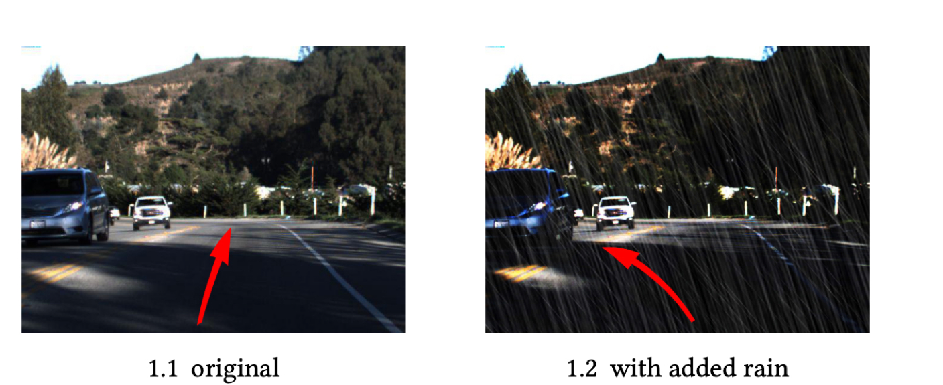
Applying fuzz testing to …
Recent: Testing self-driving system
Fuzz images

Slide 7
Fuzzing is an infinite space problem
For any piece of software, the set of invalid inputs is unbounded
Test cases generator must be clever enough to craft test cases that are most likely to trigger bugs in the target software

Slide 8
How to generate the test cases?
Generator-based:
Random
Template-based
Mutation-based

Slide 9
Random
Randomly generate test case
Random fuzzing is usually ineffective because the test cases are nothing like valid input.
For the most part, the test cases fail to penetrate into the target code
E.g., login function, e.g., notmecome, wrongcode!124

Slide 10







Slide 11
Template-based
A template generator creates test cases based on template and introduces anomalies into valid inputs to create test cases
grammar-based or protocol-base
In general, template test cases are much more effective than random test cases because they are mostly pass program parser checks.

Slide 12
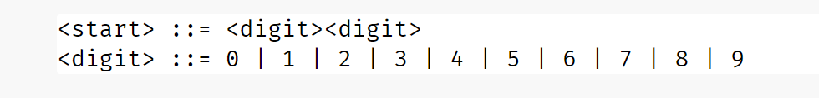
We use specific grammar to define the templates
A grammar consists of a start symbol and a set of expansion rules (or simply rules) which indicate how the start symbol (and other symbols) can be expanded.
As an example, consider the following grammar, denoting a sequence of two digits, eventually yielding value between 00 and 99.
https://www.fuzzingbook.org/html/Grammars.html

Slide 13
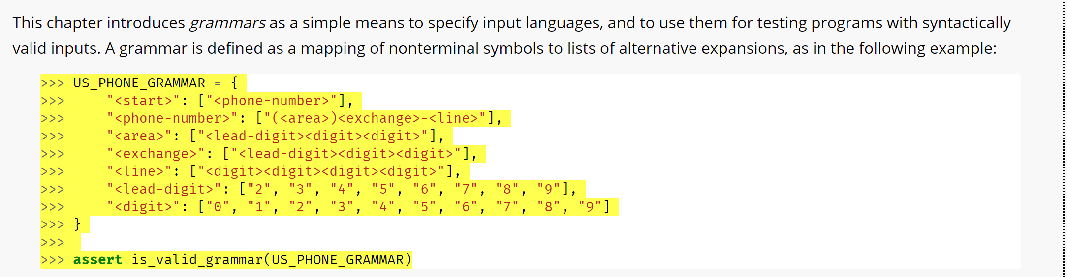
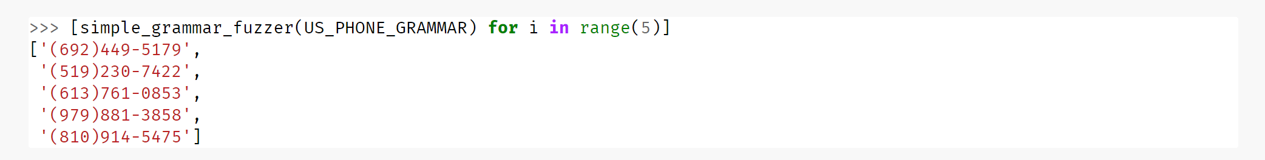
We use specific grammar to define the templates
https://www.fuzzingbook.org/html/Grammars.html

Slide 14
How to generate the test cases?
Generator-based:
Random
Template-based
Mutation-based

Slide 15
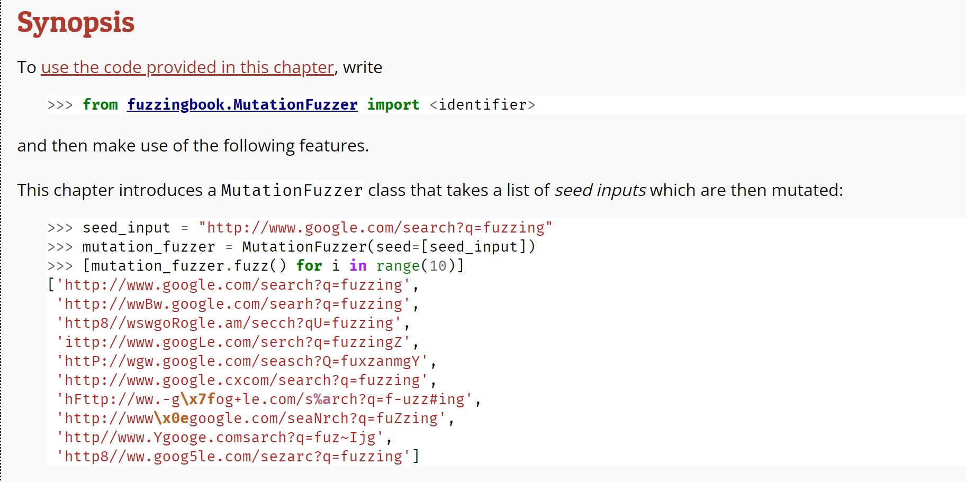



Mutation-based
Introducing small changes to existing inputs that may still keep the input valid, yet exercise new behavior.
Mutation: Insertion, deletion, and replacement
https://www.fuzzingbook.org/html/MutationFuzzer.html

Slide 16


Guided Mutation-based
Target system
Seed (initial candidates)
Mutated candidates
mutation
Leverage target system feedback to refine the mutation operation.
Evaluator (time/coverage)
Selected candidates

Slide 17
Oracles for fuzz testing
Types of failure
Crashes
Endless loops
Resource leaks or shortage
…

Slide 18
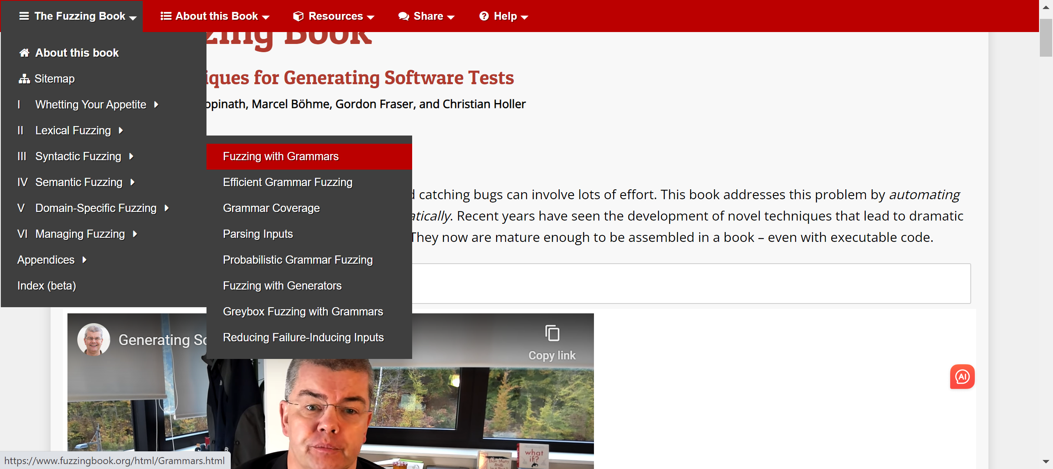
https://www.fuzzingbook.org/

Slide 19
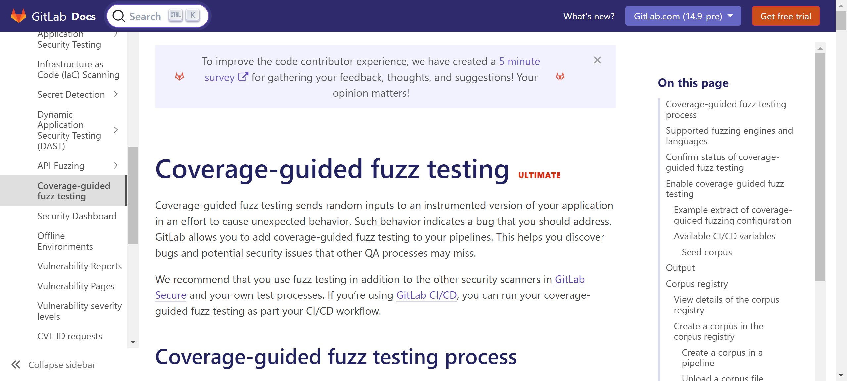
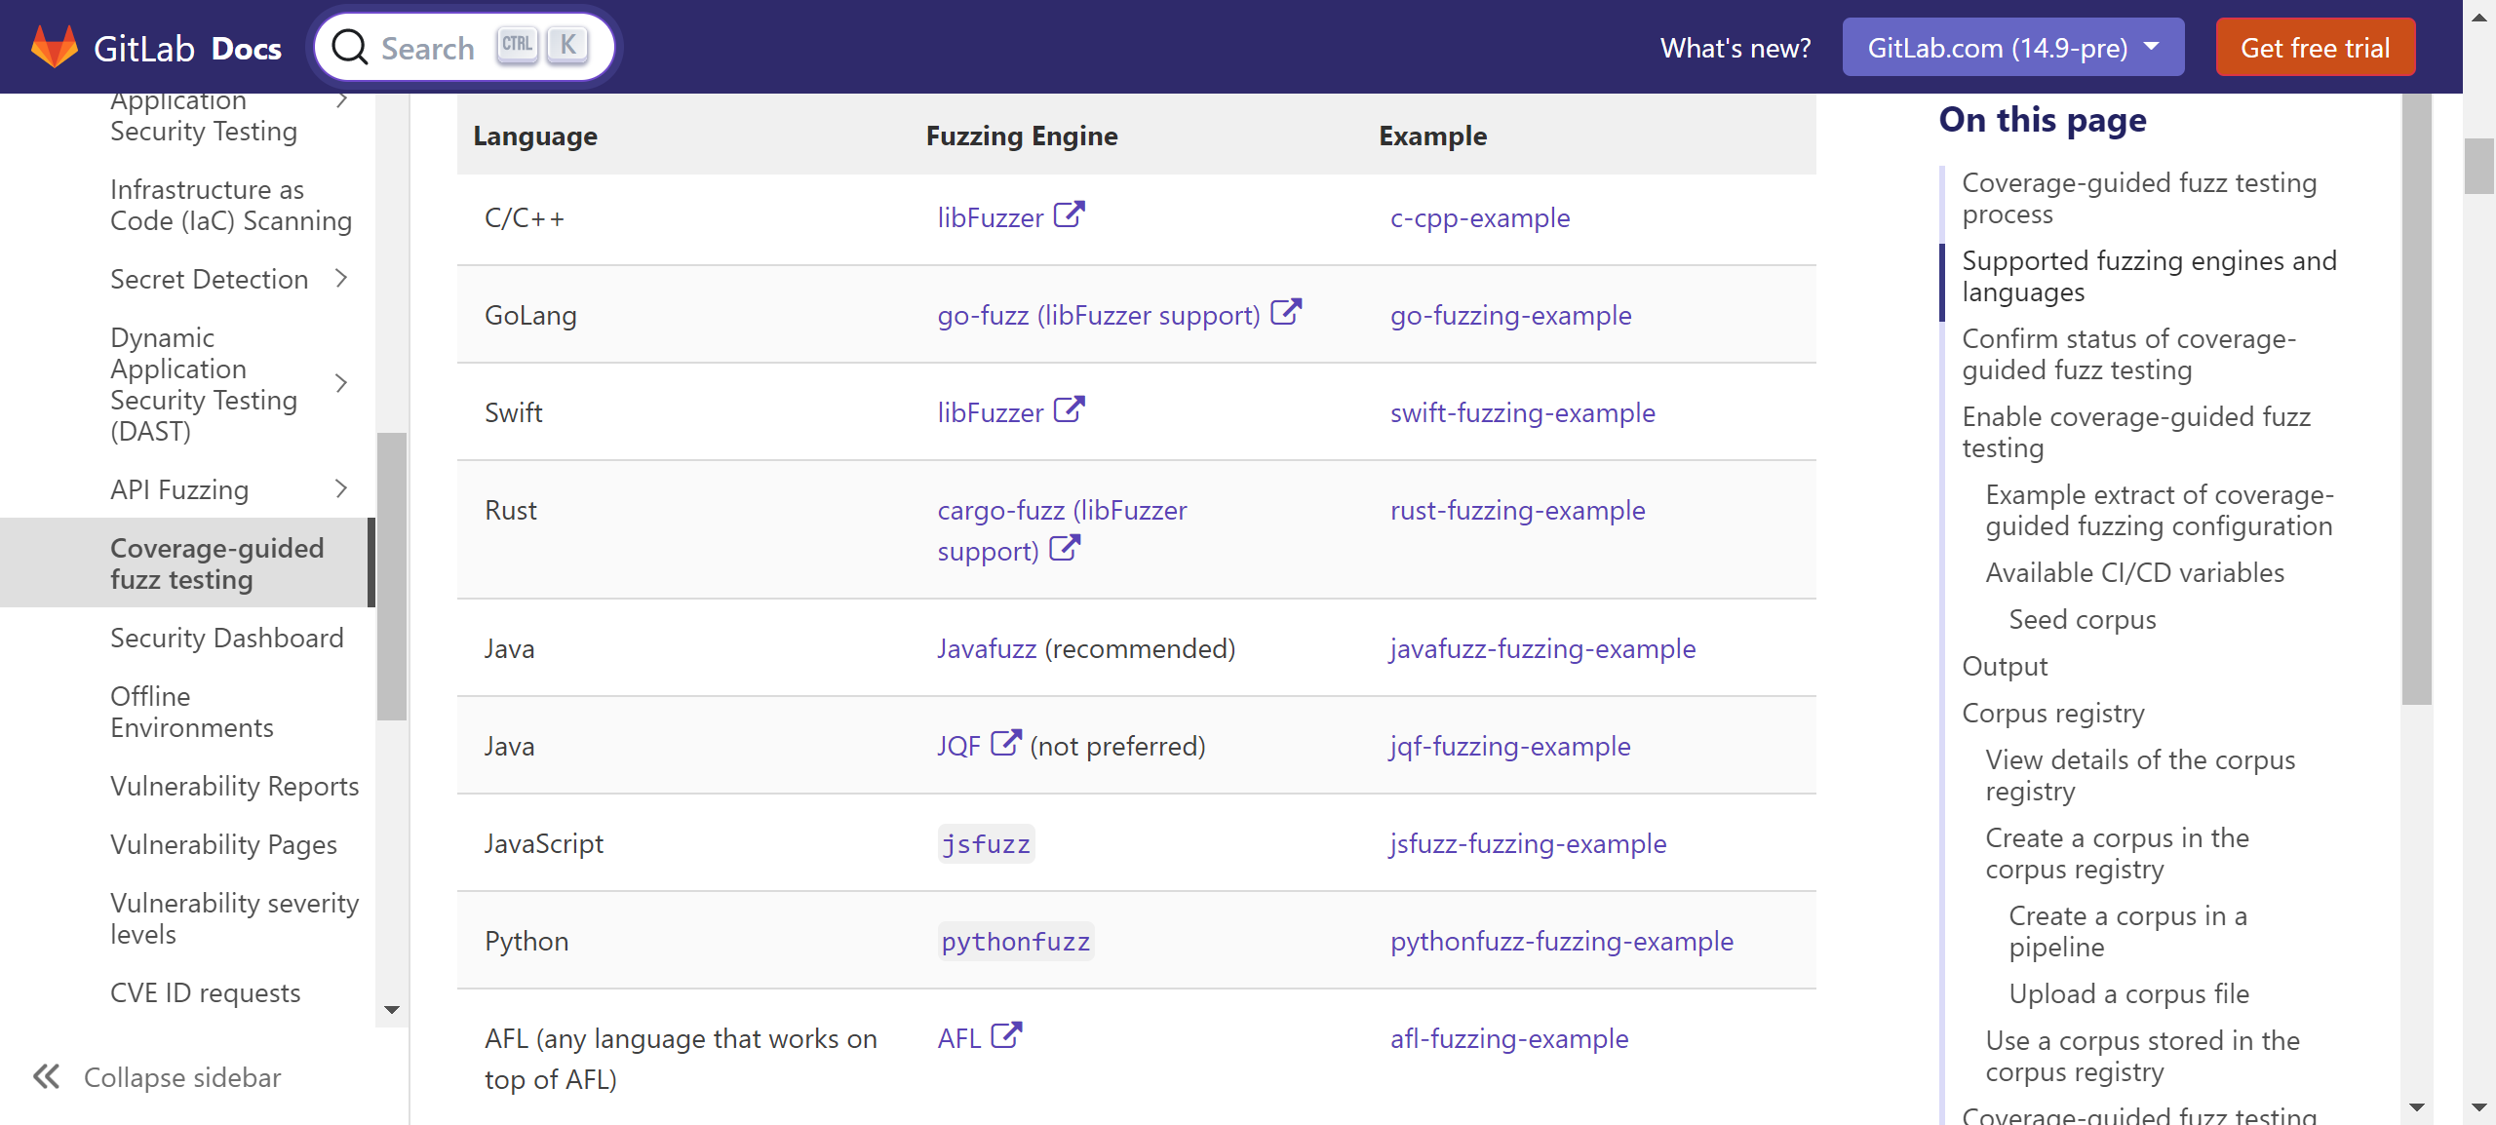
https://docs.gitlab.com/ee/user/application_security/coverage_fuzzing/

Slide 20


Slide 21
Research on using LLM for fuzzy testing
Large Language Models are Zero-Shot Fuzzers: Fuzzing Deep-Learning Libraries via Large Language Models, by Zhang et al.
Goal: Generate a large amount of test code containing a set of target APIs
For instance, our target library is tensorflow, the approach uses the LLM to generate a large number code containing APIS in tensorflow, for finding bugs in tensorflow
https://arxiv.org/pdf/2212.14834.pdf

Slide 22
LLM-based fuzzy generation
Key insight is that
modern LLMs can include numerous code snippets using various DL libraries in their training corpora (e.g., there are >400,000 TensorFlow/PyTorch projects on GitHub, which is an important training source for modern LLMs)
allowing them to implicitly learn both Python syntax/semantics and intricate types/constraints of DL APIs to directly generate/mutate valid DL programs for fuzzing DL libraries.

Slide 23
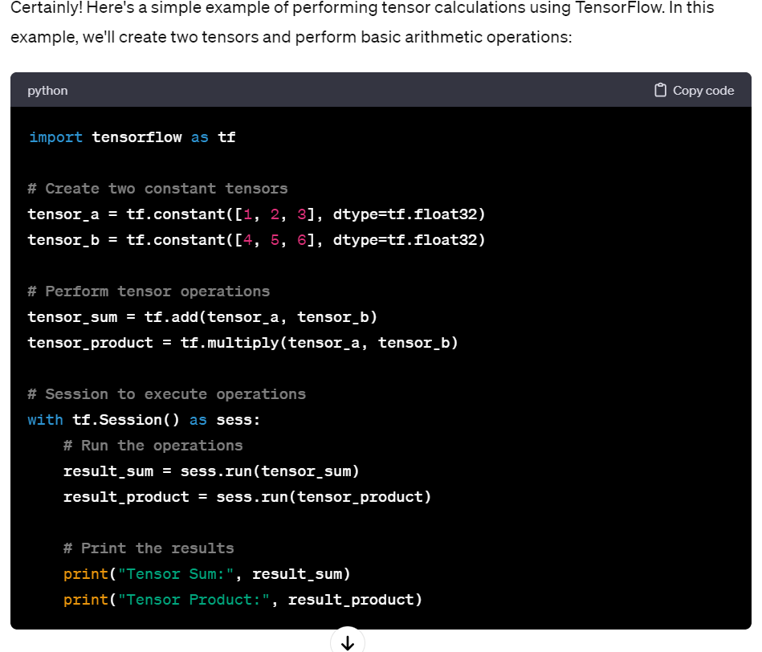
Generate code for tensor operation

Slide 24
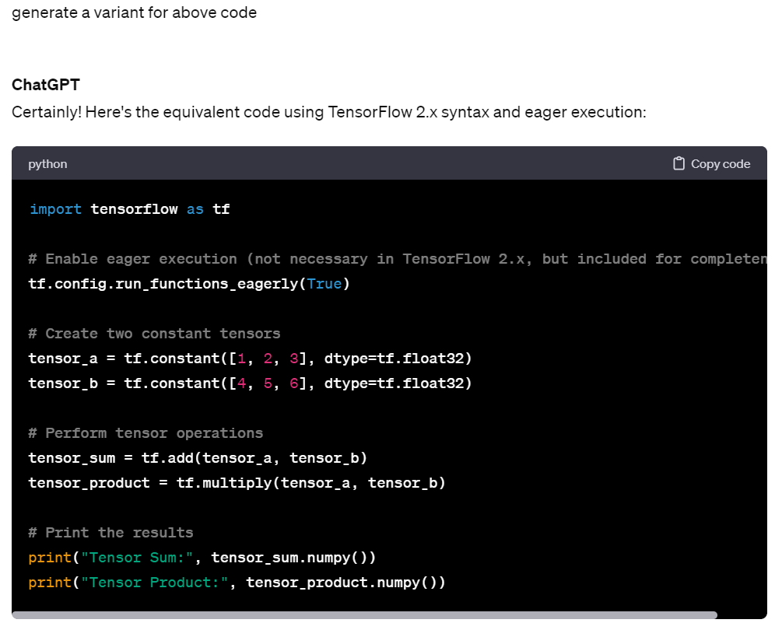

Slide 25
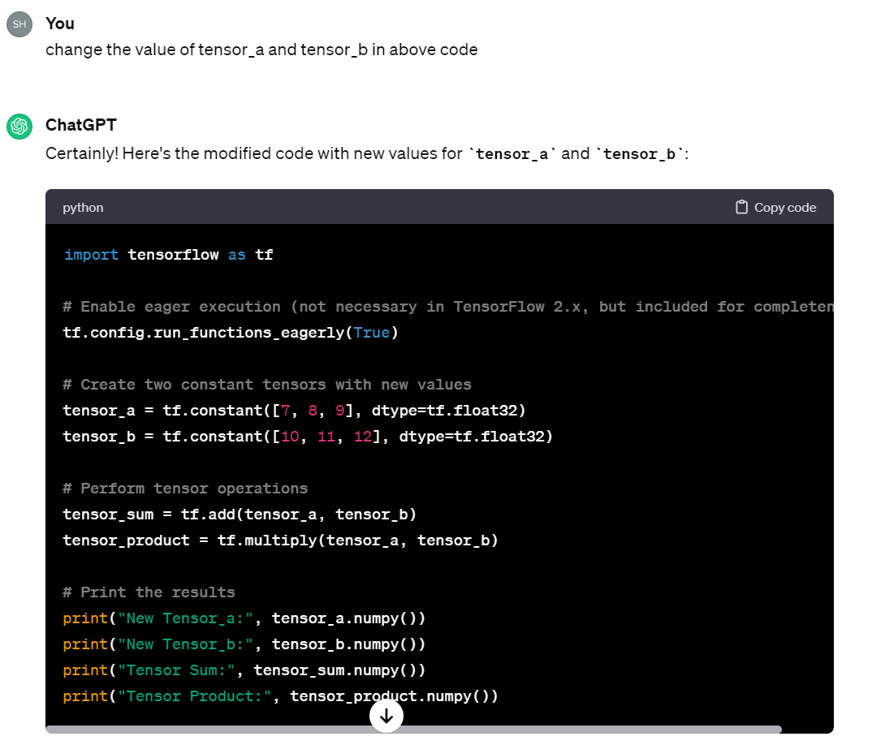

Slide 26
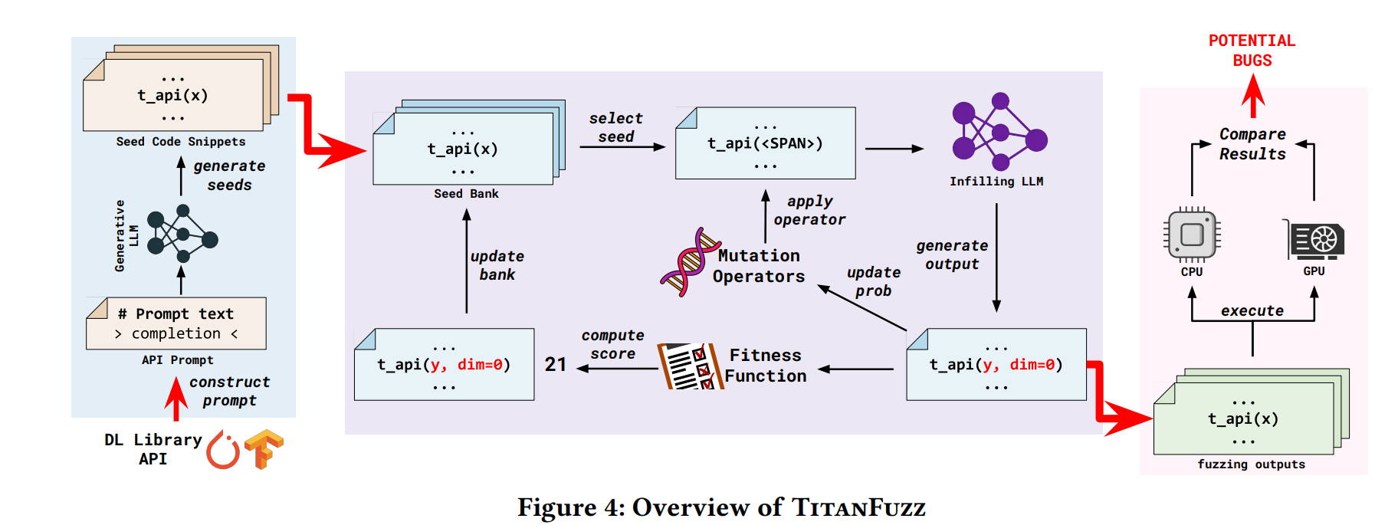
Overview of the approach
Notes:
https://arxiv.org/pdf/2212.14834.pdf

Slide 27
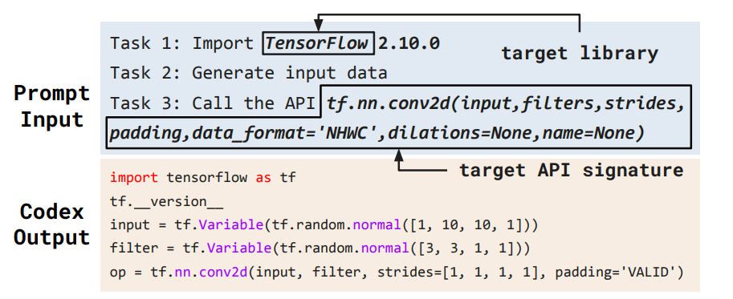
Starting from a seed program generated by LLM
Notes:
Computes a 2-D convolution given input and 4-D filters tensors.

Slide 28
Overview of the approach
Notes:
https://arxiv.org/pdf/2212.14834.pdf

Slide 29
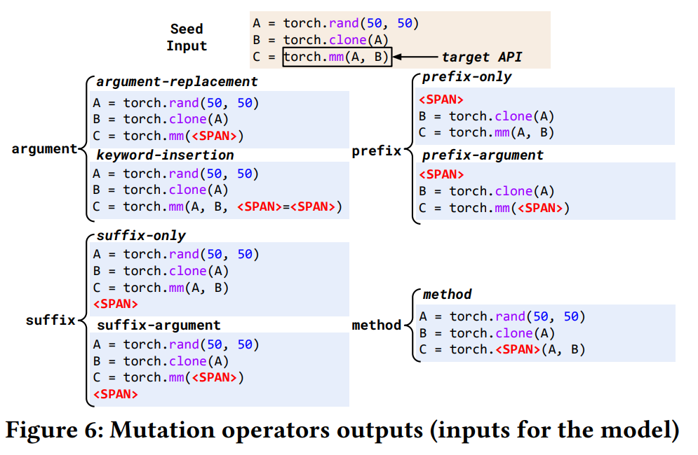
Perform mutation operation to generate more program for testing
The masked out (<SPAN>) regions in the code, then feed into the InCoder model to infill the masked regions with sampling.
Argument: replace mutation operator which replaces the API call arguments with the span token
Prefix and suffix mutation operators: choose a code segment (spanning one or multiple lines) before or after the target API invocation to insert the span token.
Method: replaces a randomly chosen library API method name with a span token.
Notes:
The inspiration comes from prior work [16], which shows that it is common in DL libraries for related APIs to share the same input, and borrowing inputs from one API can help trigger bugs in its relational APIs.

Slide 30
Mutation Operator Selection – how?
We have multiple mutation operations (argument, prefix/suffix, method)
The assumption is that the mutation operator that works well (e.g., generating more bug triggering mutants) can be different for different DL APIs.
Objective: generating program from seed code snippets using mutation that that are valid and different from historical generations.
Notes:
Intuitively, the validity of generated code snippets from a mutation operator can be a strong hint for prioritizing/deprioritizing the operator.

Slide 31
Mutation Operator Selection – how?
Question: we do not have any prior knowledge which mutation can achieve the objective. How can we identify mutation operators that help generate more valid and unique code snippet?
We need to estimate the probability of an operators resulting in a more valid and unique code snippets during the fuzzing.
We formulate the question as Bernoulli bandit problem.

Slide 32

Bernoulli bandit problem
Notes:
https://www.youtube.com/watch?v=nkyDGGQ5h60
Each operation could be considered as bandit
Sampling process could be considered as select the operation from the mutation pools

Slide 33
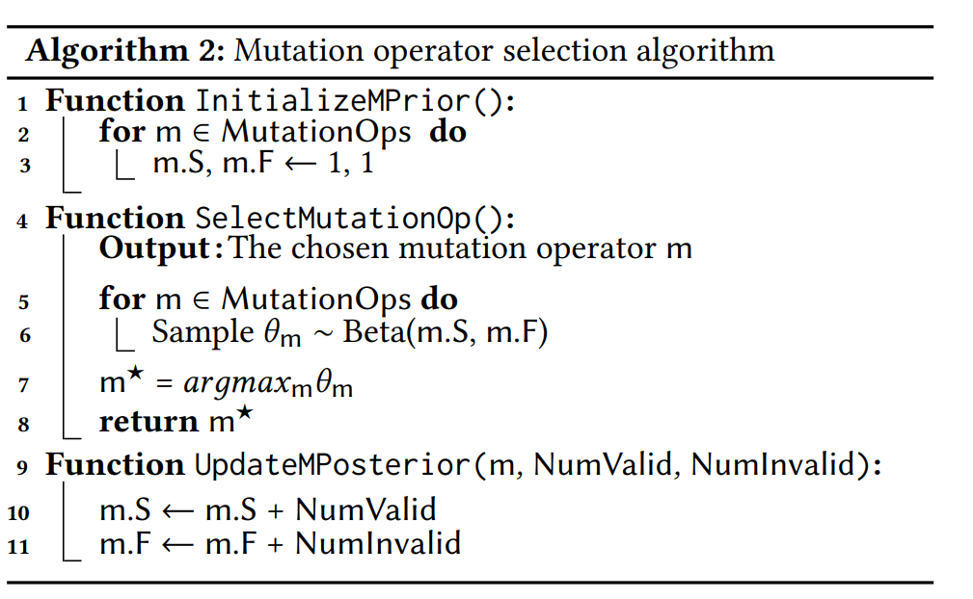
Algorithm

Slide 34
Overview of the approach
Notes:
https://arxiv.org/pdf/2212.14834.pdf

Slide 35
Fitness function
Design a fitness function and score to rank each generated program.
The intuition behind the fitness calculation is to give higher scores to the generated mutation programs with
deeper execution path
more diverse computation graph
more complicated API invocations

Slide 36
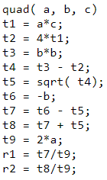
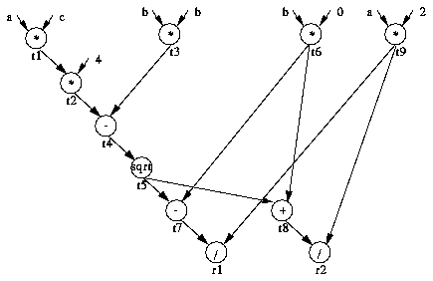



Depth of dataflow graph
Dataflow graph with each edge representing data dependencies between two operations.
The depth of the dataflow graph (D) is defined as the maximum number of edges in any path of the graph

Slide 37
Number of API calls
We count the number of unique library API calls (U) that exist within each code snippets.
Since LLM tends to generate many code snippets where code line(s) are repeated, we also count and penalize the number of library APIs that are repeatedly called with the same inputs (R).
FitnessFunction(𝐶) = D + U − R

Slide 38
Oracle
Execute the generated code snippets on CPU and GPU, record all the variables including the intermediate ones, and detect potential bugs.
Wrong-Computation: Difference in computed values can indicate a potential semantic bug in different backend implementations of a library API or interactions between different APIs.
Crash: During program execution, we also detect unexpected crashes, e.g. segmentation faults, aborts, INTERNAL_ASSERT_FAILED errors. Such crashes indicate failures to check or handle invalid inputs or corner cases, and can lead to security risks.

Slide 39
Differential fuzzing
Differential testing,^{[1]} also known as differential fuzzing, is a popular software testing technique that attempts to detect bugs, by providing the same input to a series of similar applications (or to different implementations of the same application), and observing differences in their execution

Slide 40
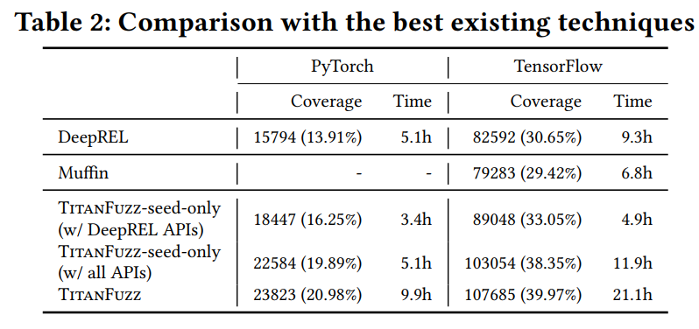
Coverage

Slide 41
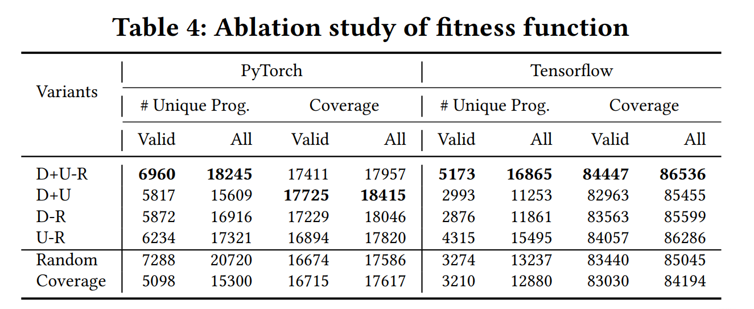
The effectiveness of operation selection algorithm

Slide 42
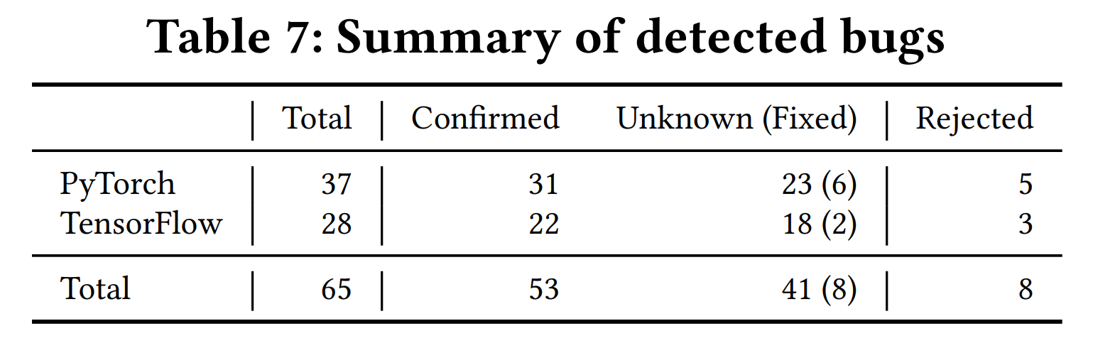
Bugs detected

Slide 43
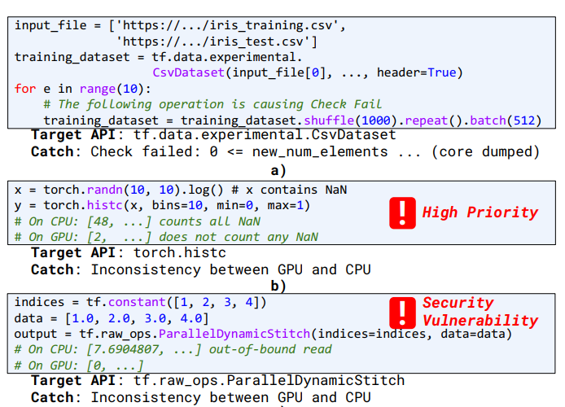
Notes:
igure 9b shows a bug in the torch.histc API where on CPU the API incorrectly counts NaN values as part of the first bin in the histogram. This bug is only found through TitanFuzz as it relies on a chained API sequence of first generating the regular random input and then applying the log function which can generate NaN values for negative inputs. Due to the silent incorrect computation, PyTorch developers have labeled this as a high priority bug.

Slide 44
Summary
Generator-based:
Random
Template-based
Mutation-based
Research on fuzzy testing

